Slide 1
How to increase your chances of getting an A, at Rutgers Moody’s Class.
Ali Awari – aka87

Slide 2
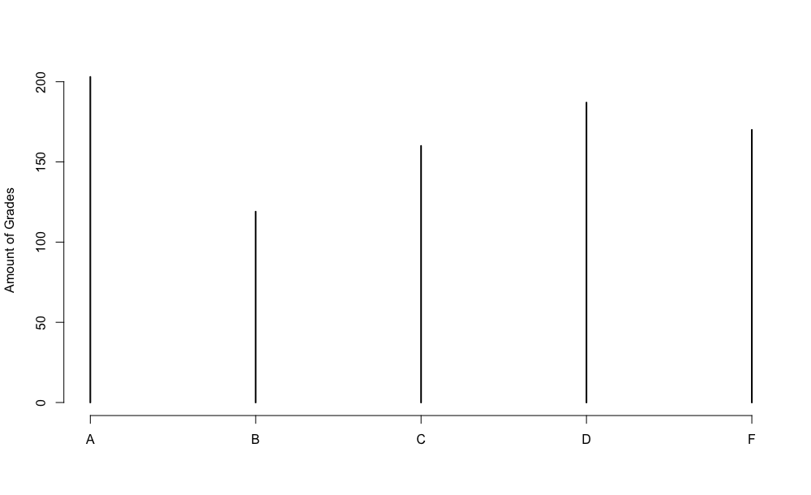
Grade Distribution
A | B | C | D | F
203 | 119 | 160 | 187 | 170
Things to note:
Quite a bit of A’s in the class
Not much difference between them all
Not much to work with
plot(table(mo$GRADE), ylab="Amount of Grades")

Slide 3
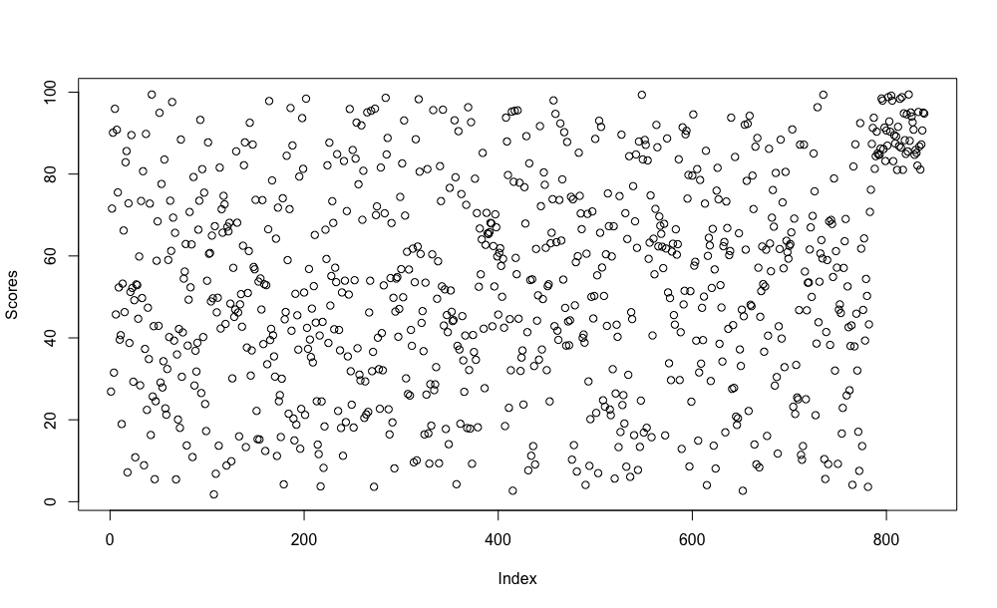
Score Distribution
Things to note:
Scores all over the place
Weird anomaly of data in the top left corner
Not much to work with.
plot(mo$SCORE, ylab="Scores")

Slide 4
Subsets of the Data
How can we remove the ambiguity from this data?
What if we split all the data into those who receive A, B, C, D, and F to analyze?
We can do that with something like subset(mo, GRADE==‘A’)!
We can then check everything with summary(subset_name)

Slide 5
Subsets of the Data CONT.
SCORE | A | B | C | D | F
Min | 66.55 | 58.57 | 42.60 | 22.15 | 1.78
Max | 99.44 | 81.93 | 71.57 | 39.84 | 34.65
Median | 87.36 | 68.04 | 54.55 | 54.47 | 17.05
Things to note:
Minimum is useless
Median is useless
Max is interesting, because while there may be individuals with scores of less than 82, there are no scores greater than 82 with less than an A.
summary(mo_A), summary(mo_B), summary(mo_C), summary(mo_D), summary(mo_F)

Slide 6
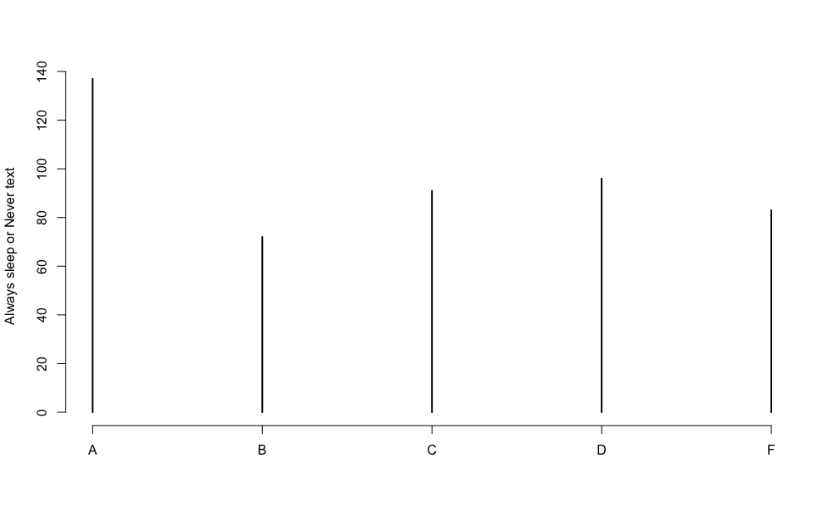
Dozes off, & Texting
Turns out that most of the people who have A’s either:
Never text in class.
Always sleep.
Let’s create a subset with relation to the whole dataset, then graph it.
Not bad.
plot(table(mo_notxt_sleep$GRADE), ylab="Always sleep or Never text”)

Slide 7
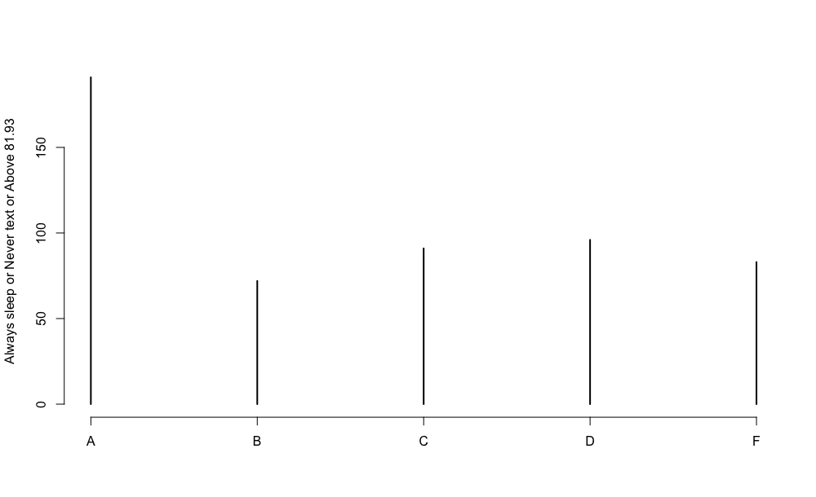
Let’s bring it all together
This graph is a combination of the last two. We finally created by a significant margin, a way to pass Moody’s class.
To summarize:
Score higher than 81.93
Always sleep
Never Text
plot(table(mo_notxt_sleep_8193$GRADE), ylab="Always sleep or Never text or Above 81.93")

